Slide 1
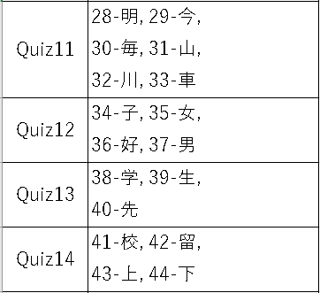
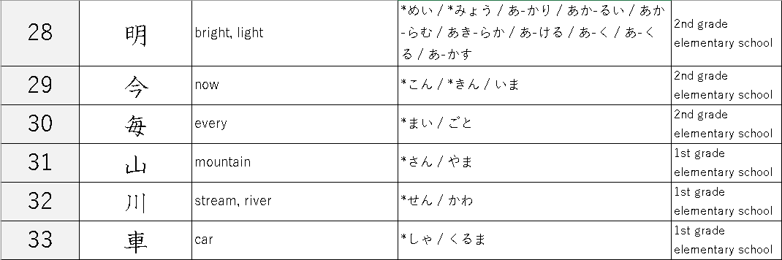

Slide 2


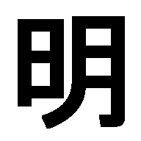
the Sun
the Moon
the Sun + the Moon
→ bright, light

Slide 3
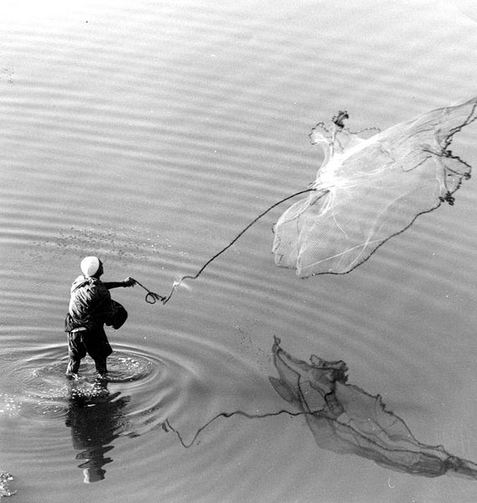
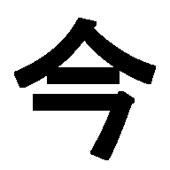
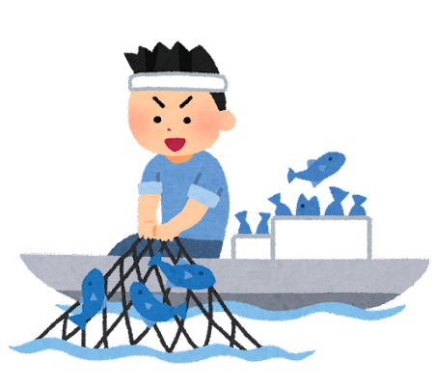

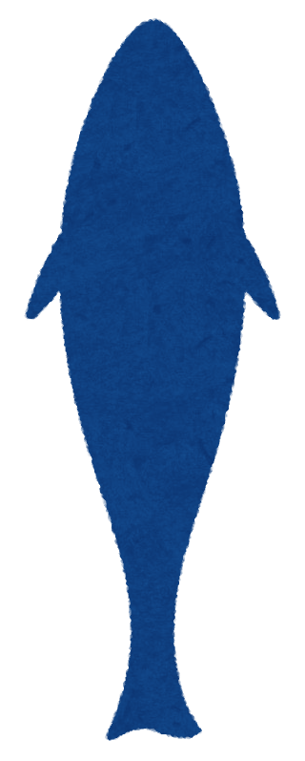

مراد الداغستاني (Murad al-Daghistani), Public domain, via Wikimedia Commons
https://commons.wikimedia.org/wiki/File:Murad-Net_Casting.jpg
the best timing for throwing a cast net.
now-or-never chance
now
cast net
fish

Slide 4

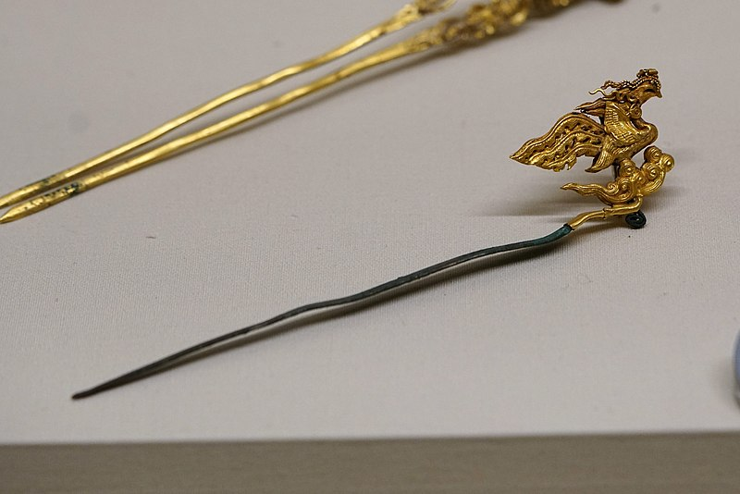
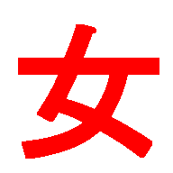


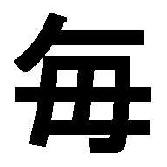

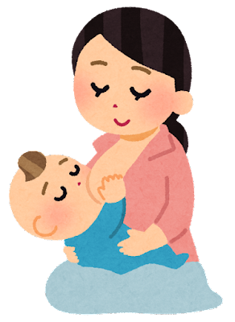
https://en.wikipedia.org/wiki/Chinese_hairpin
https://en.wikipedia.org/wiki/File:凤首金顶银簪03564.jpg
Augusthaiho , CC BY-SA 4.0
woman, female
hairpin
mother
mother
Hairpins were used as every day hair ornaments in ancient China
→ every

Slide 5

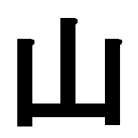
pictograph of ‘mountain’

Slide 6
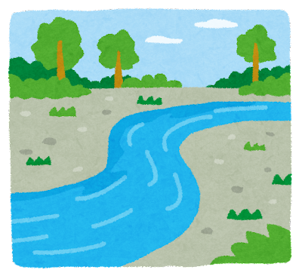

pictograph of ‘river’

Slide 7
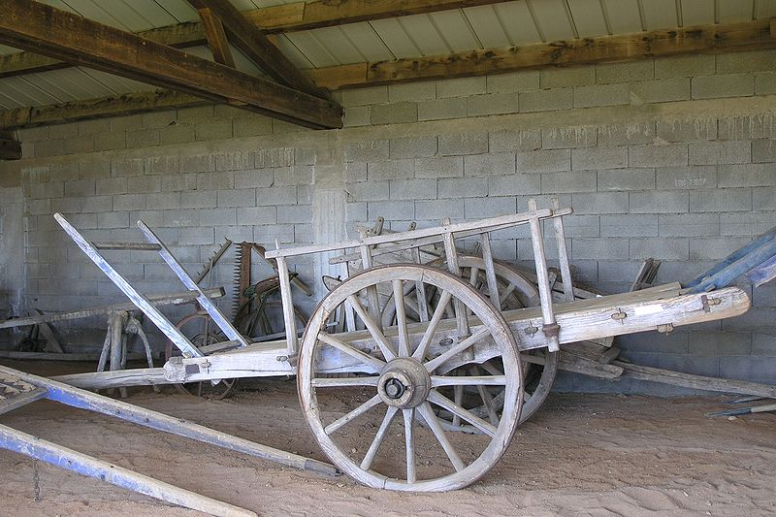

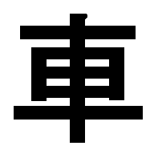
https://commons.wikimedia.org/wiki/File:Cart.jpg by Deps~commonswiki
Deps~commonswiki, Public domain, via Wikimedia Commons
pictograph of ‘cart/wagon’
→ car, wheel

Slide 8
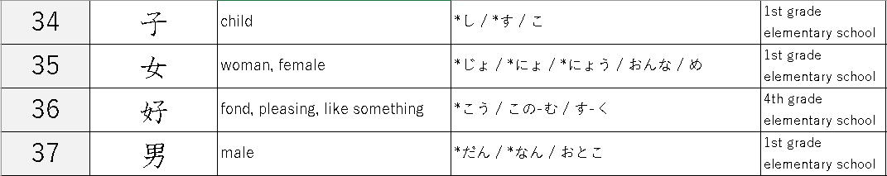

Slide 9

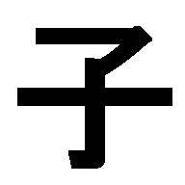
pictograph of ‘baby’
→ child

Slide 10
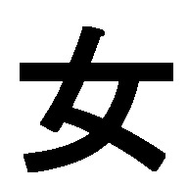
pictograph of ‘woman/female’

Slide 11
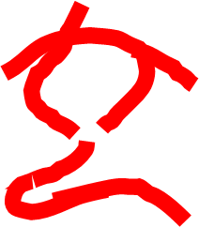
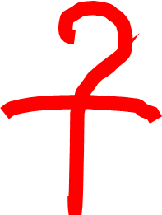


woman,
female
child
mother’s love
to like
  favorite

Slide 12
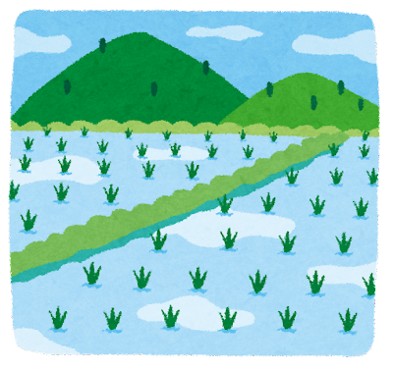


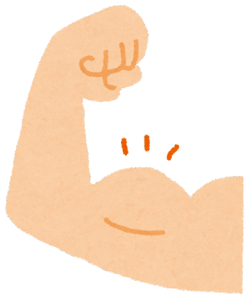
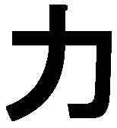
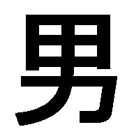
rice field
farm work
→ physical labor
→ male
power
large bicep

Slide 13
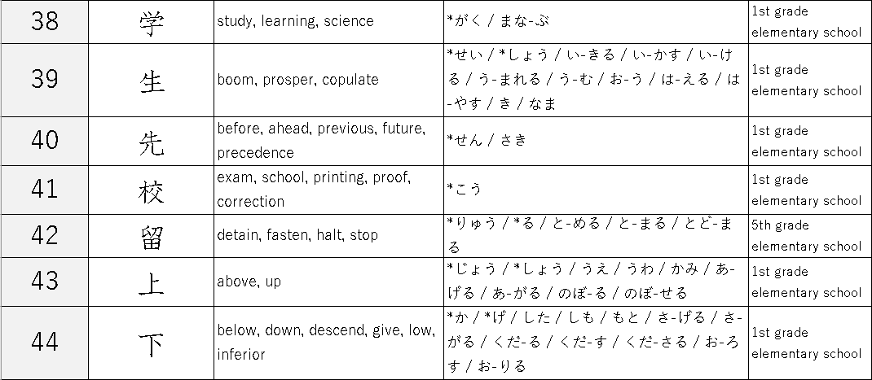

Slide 14
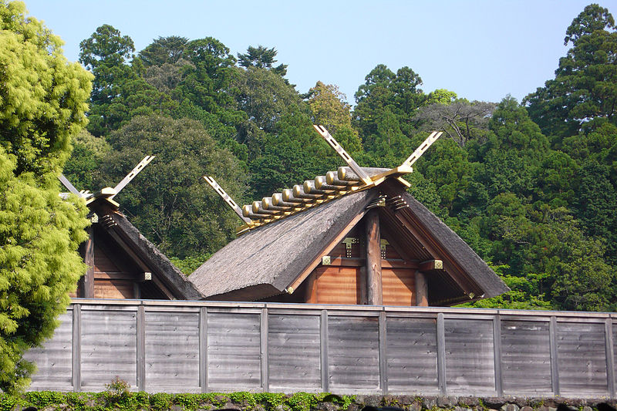
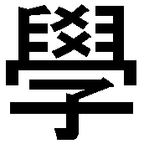
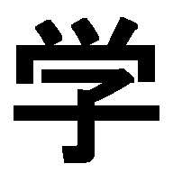

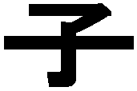
ancient roof architecture (public building)
https://commons.wikimedia.org/wiki/File:Naiku_04.jpg by N yotarou
N yotarou, CC BY-SA 4.0 <https://creativecommons.org/licenses/by-sa/4.0>, via Wikimedia Commons
old character form
simplified form
child
Children study in the public building
→ study, learning

Slide 15

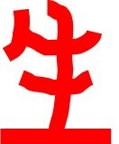
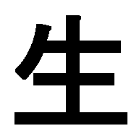
growing plant
→ be born, life,
be living

Slide 16
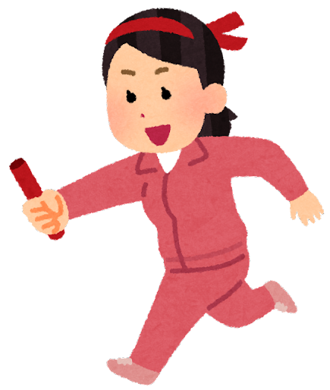
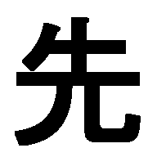
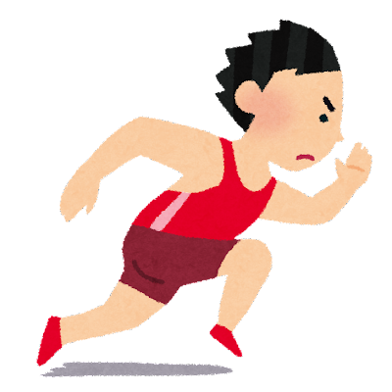
running people
they can go further
ahead, future,
precedence
they can arrive before walking people

Slide 18
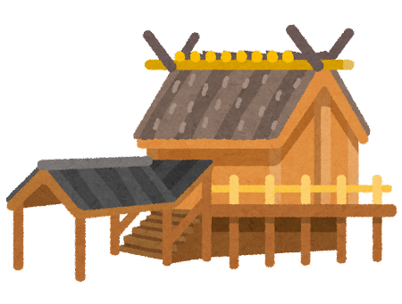
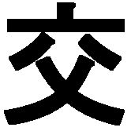

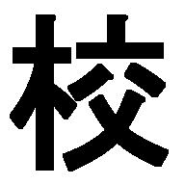
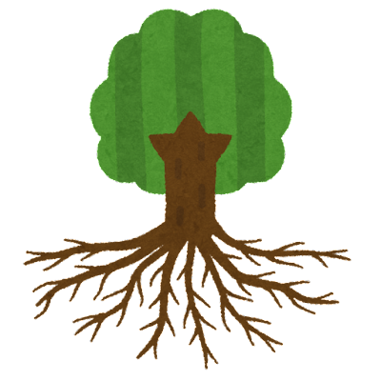
ancient roof architecture (public building)
https://commons.wikimedia.org/wiki/File:Naiku_04.jpg by N yotarou
N yotarou, CC BY-SA 4.0 <https://creativecommons.org/licenses/by-sa/4.0>, via Wikimedia Commons
crossbeams on the gable
→ crossing, mixing
place of teaching and learning
→ school
wooden building

Slide 19
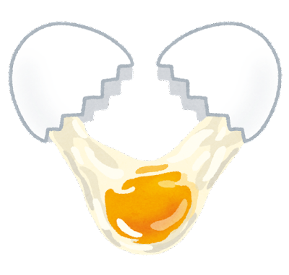
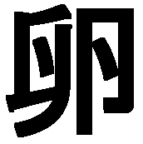
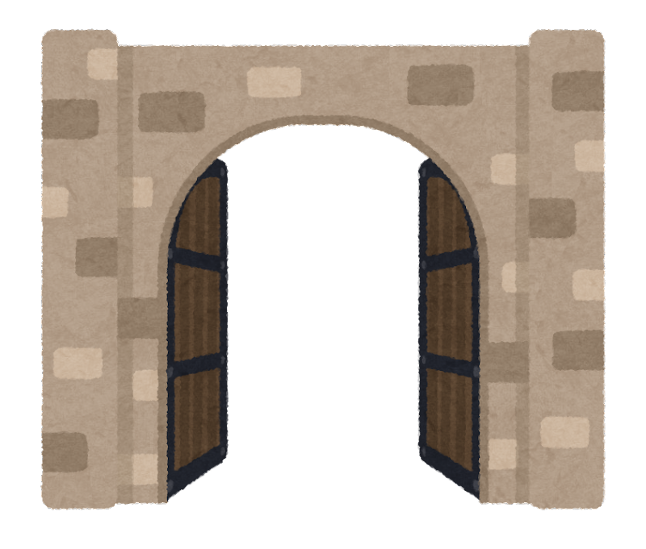

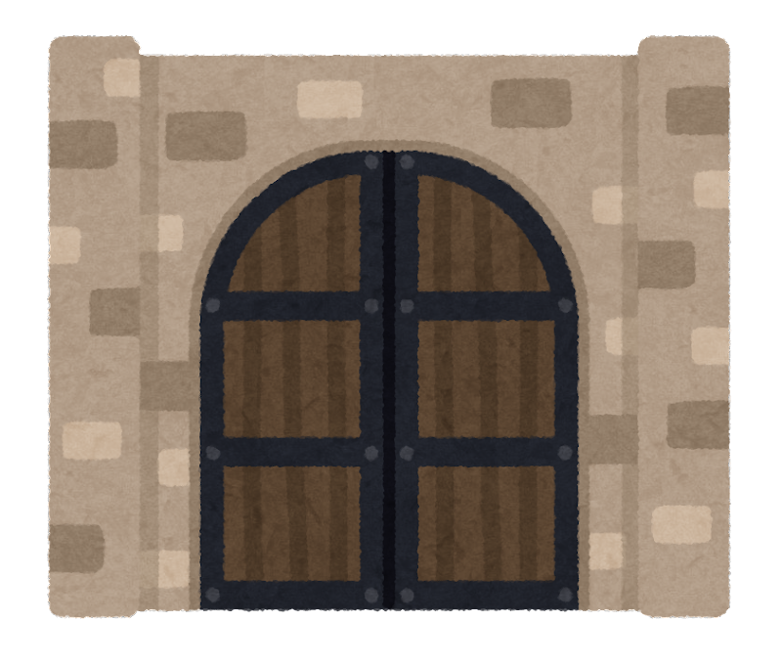

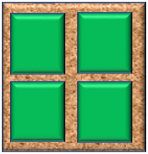
egg
opened
gate
closed
gate
a water gate to contain the flow of water or to supply the rice field with water.
to stay for a certain purpose
stay (and study) abroad
rice field

Slide 20
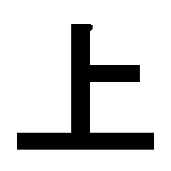

Slide 21
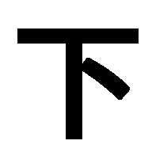

Slide 22
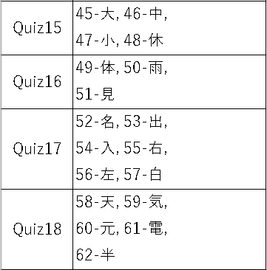
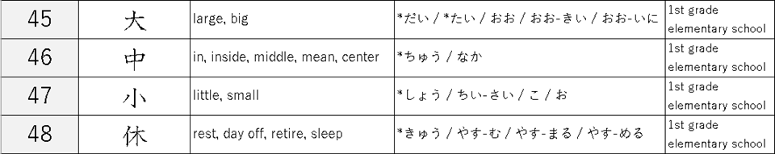

Slide 23

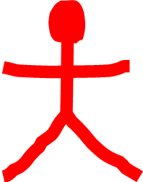
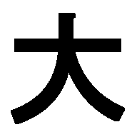
big gesture
→ big, large

Slide 24



to hit a target in the middle
→ middle, center

Slide 25
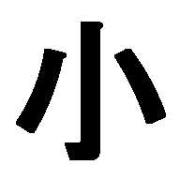
baby
→ little, small

Slide 26




person
a variant form of “person” kanji
tree
to rest in the shade of a tree
→ to rest, day off

Slide 27


Slide 28



root
→ basis, foundation
basis of information
a book
root
root
The eight trigrams (tree diagram) used in Daoist cosmology.
The research and record book on Cosmology
a book
Gmk35298, CC BY-SA 4.0 <https://creativecommons.org/licenses/by-sa/4.0>, via Wikimedia Commons
https://commons.wikimedia.org/wiki/File:Creation-of-bagua.png

Slide 29


root
person
a variant form of “person” kanji
basis, foundation
the basis of human
→ the body

Slide 30





Rain falling from the cloud

Slide 31






eye
eye
to look at
to watch
a person looking at something
person

Slide 32


Slide 33









https://en.wikipedia.org/wiki/Chinese_bronze_inscriptions
about BCE 1000(3000 years ago)
meat
meat
https://en.wikipedia.org/wiki/Seal_script
about BCE 100(2100 years ago)
unborn baby(fetus)
(crying) newborn baby
crying
Naming ceremony
mouth

Slide 34




foot bone
→ movement by the feet
to exit, to leave
    (money leaves) → to pay

Slide 35




Wedge (Wikipedia)
https://en.wikipedia.org/wiki/Wedge
Iainf 03:12, 8 July 2006 (UTC), Public domain, via Wikimedia Commons
https://commons.wikimedia.org/wiki/File:Wedge-diagram.svg
Chmee2, CC BY-SA 3.0 <http://creativecommons.org/licenses/by-sa/3.0/>, via Wikimedia Commons
https://commons.wikimedia.org/wiki/File:%C5%A0palek_na_%C5%A1t%C3%ADp%C3%A1n%C3%AD.jpg
to wedge the wood
→to enter, to insert

Slide 36




Seal script
https://en.wikipedia.org/wiki/Seal_script
about BCE 100(2100 years ago)
Many people grab food to eat with right hand.
→ right (-hand side)

Slide 37





Seal script
https://en.wikipedia.org/wiki/Seal_script
about BCE 100(2100 years ago)
When hammering, many people hold the board and nail with the left hand.
→ left (-hand side)

Slide 38





Chinese bronze inscriptions
https://en.wikipedia.org/wiki/Chinese_bronze_inscriptions
or
about BCE 1000(3000 years ago)
skull
→ white color

