Slide 1
Free Kanji Material 無料漢字教材 kanji0254-0258 新城直樹
本漢字教材は個人、法人、商用、非商用問わず無料でご利用頂けます。
ただし，一部の画像ファイルはクリエイティブ・コモンズ・ライセンスに基づいて利用していますので，例えば，ご自身で加工・編集したものを公開・配布する場合は自己責任で条件をお守りください。
書き順のGIFファイルは全て新城が作成したものです。書き順のGIFファイルを編集・加工するために編集用ファイルがほしいという方はご連絡ください（RealPaintで作成しましたので，rliファイルをお渡しします）。

Slide 2

本教材は，下記のPRQMakerの語彙リスト（1006kanji_VocabularyList.xlsx）に基づき作成しています。
http://isu.skr.u-ryukyu.ac.jp/staff/arashiro/

Slide 3
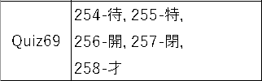
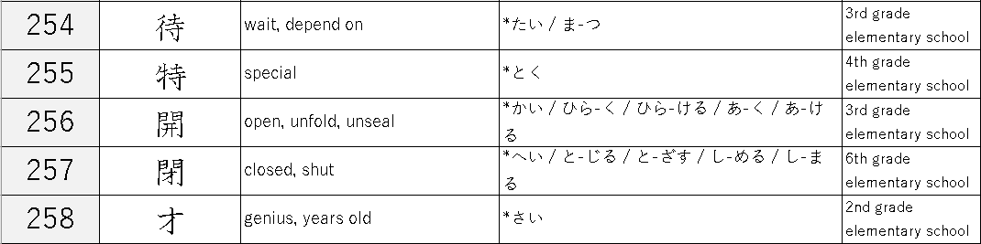

Slide 4




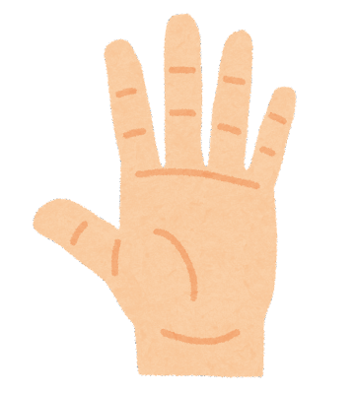
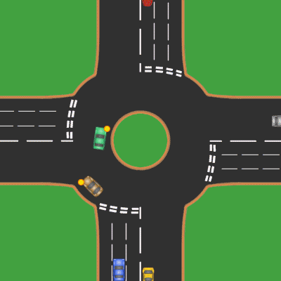

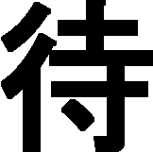
to move hands and feet to give hospitality
to give the pilgrims hospitality
Accommodation for the pilgrims
a temple
foot
temple
hand
The pilgrims wait for their companions at the intersection of the streets.
to wait
“crossroad”
https://commons.wikimedia.org/wiki/File:UK_Roundabout_8_Cars.gif
originally created by Mintguy, prettified by Fredrik, CC BY-SA 3.0 , via Wikimedia Commons

Slide 5
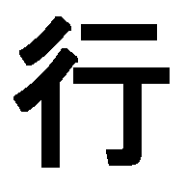
https://commons.wikimedia.org/wiki/File:UK_Roundabout_8_Cars.gif
originally created by Mintguy, prettified by Fredrik, CC BY-SA 3.0 <http://creativecommons.org/licenses/by-sa/3.0/>, via Wikimedia Commons
crossroad, street
→ come and go on the street
to go

Slide 6
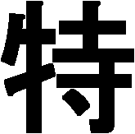

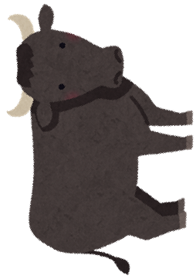
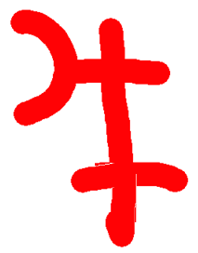
to move hands and feet to give hospitality
to give the pilgrims hospitality
Accommodation for the pilgrims
a temple
foot
temple
hand
In India, the birthplace of Buddhism, the cow is a sacred animal.
→ special animal
special
radical
“cow/bull”

Slide 7
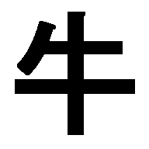
pictograph of “cow/bull”

Slide 8


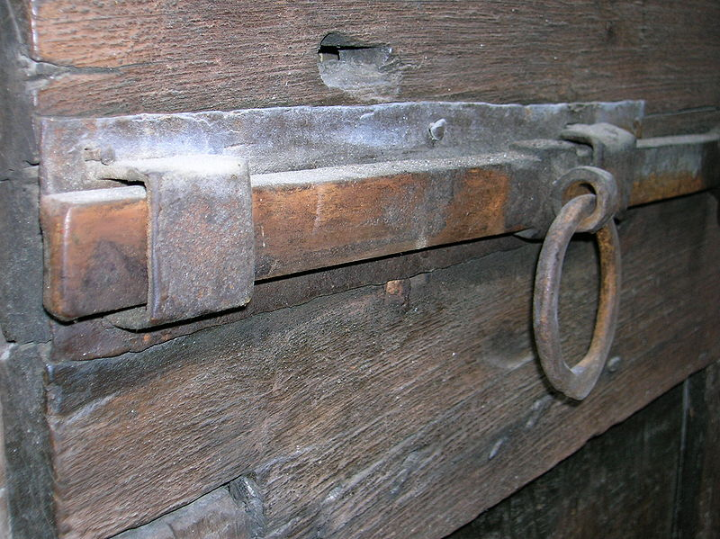


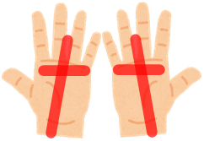

https://commons.wikimedia.org/wiki/File:Asso,_chiavistello_porta_Magnocavallo.JPG
No machine-readable author provided. Dacxjo~commonswiki assumed (based on copyright claims)., CC BY-SA 3.0, via Wikimedia Commons
radical “gate”
gate bar
to unbar the gate with both hands and open it
to open
both hands

Slide 9

Pictograph of “gate”

Slide 10
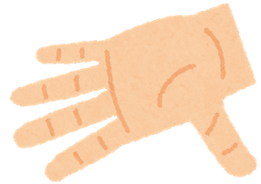
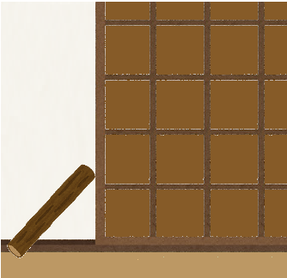
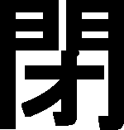
to spread the palm tightly
→ tension pole
to bar the gate
to close
radical “gate”
A bar for fastening a sliding-door

Slide 11

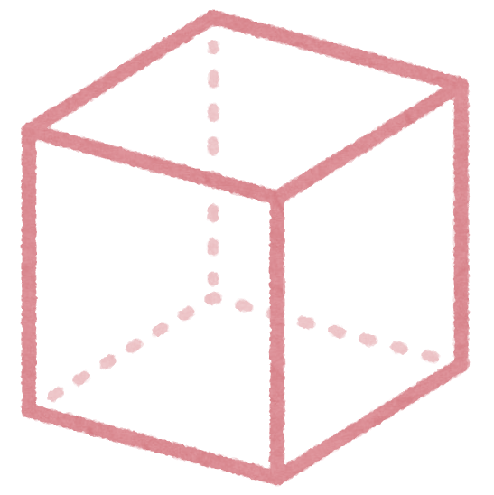
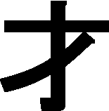
才 is not currently used as a unit of volume, only as a unit of age.
尺（しゃく）： a traditional Chinese unit of length that was derived from the distance measured by a hand, from the tip of the thumb to the tip of the forefinger
1才 (traditional volume unit : about 27 liters)
capacity
ability, genius
  age (～years old)
a unit of the stage of ability
尺
1才 = a cube with 1 尺 on each side (about 27 liters)
尺
尺

