Slide 1
Free Kanji Material 無料漢字教材 kanji0085-0086 Advanced Kanji 新城直樹
本漢字教材は個人、法人、商用、非商用問わず無料でご利用頂けます。
ただし，一部の画像ファイルはクリエイティブ・コモンズ・ライセンスに基づいて利用していますので，例えば，ご自身で加工・編集したものを公開・配布する場合は自己責任で条件をお守りください。
書き順のGIFファイルは全て新城が作成したものです。書き順のGIFファイルを編集・加工するために編集用ファイルがほしいという方はご連絡ください（RealPaintで作成しましたので，rliファイルをお渡しします）。

Slide 2

本教材は，下記のPRQMakerの語彙リスト（1006kanji_VocabularyList.xlsx）に基づき作成しています。
http://isu.skr.u-ryukyu.ac.jp/staff/arashiro/

Slide 3

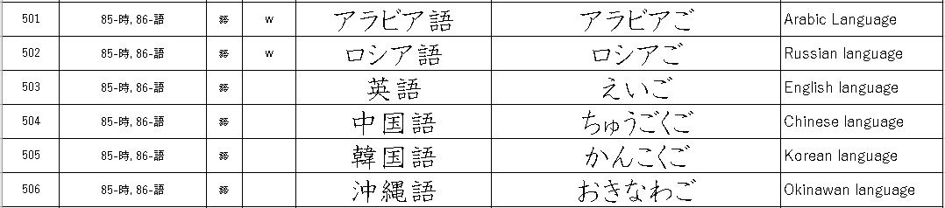
ダリー語: افغانستان
パシュトー語: افغانستان

Slide 4




radical ”water”
middle, center
sky area
area between the sky and shore
offing, offshore
open sea, ocean
offshore → middle area
shore

Slide 5
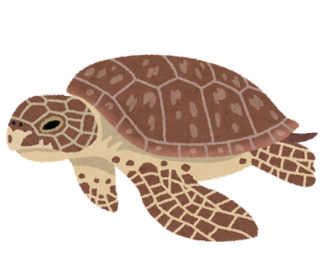
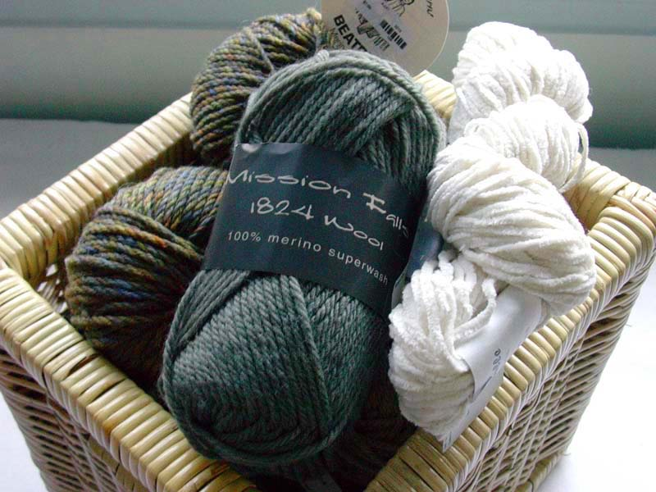

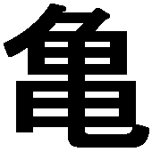
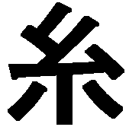
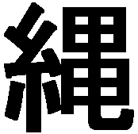
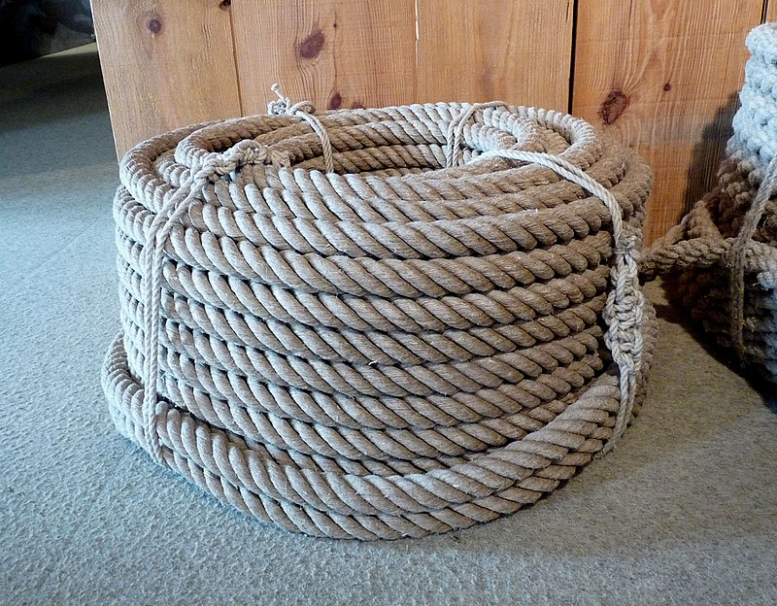
https://commons.wikimedia.org/wiki/File:A_basket_of_yarn.jpg
pixelverve.com, CC BY-SA 2.0 <https://creativecommons.org/licenses/by-sa/2.0>, via Wikimedia Commons
turtle, tortoise
a long object with hexagonal repeated pattern design
rope
yarn
→ thread → long object
https://commons.wikimedia.org/wiki/File:Cordage_en_chanvre.jpg
Ji-Elle, CC BY-SA 3.0 <https://creativecommons.org/licenses/by-sa/3.0>, via Wikimedia Commons

Slide 6
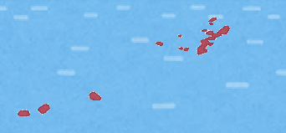
Islands that form a line like a rope in the ocean
Okinawa (islands)

Slide 7
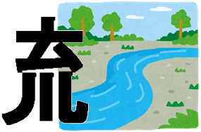
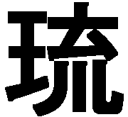
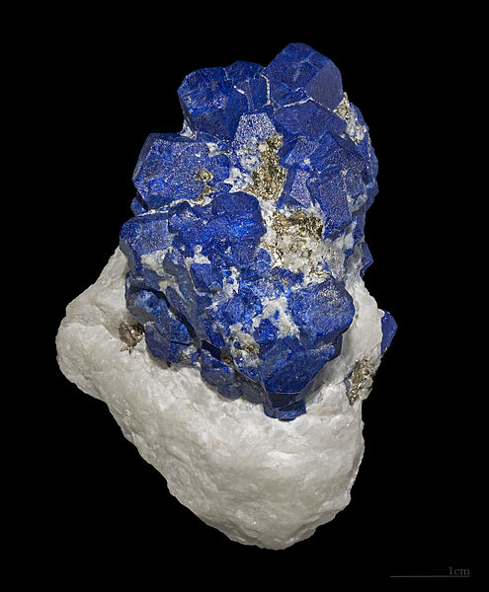
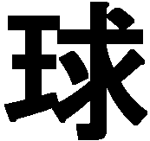
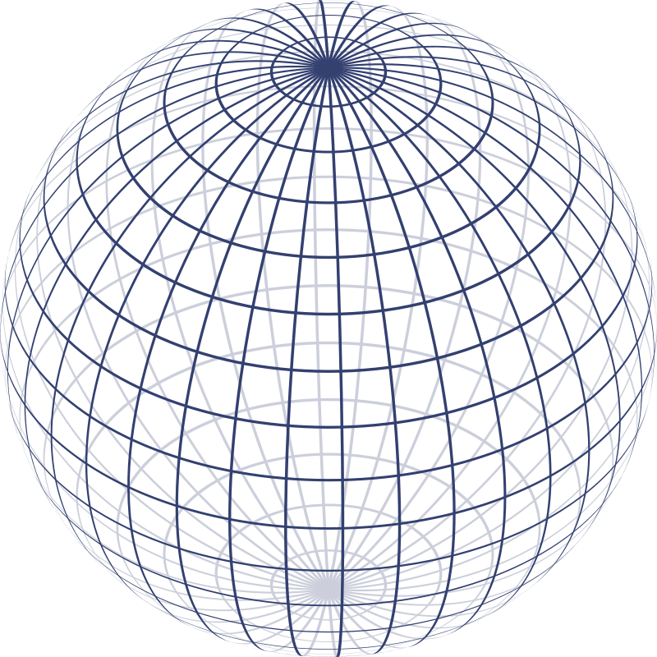
https://commons.wikimedia.org/wiki/File:Lazurite.jpg
Didier Descouens, CC BY-SA 4.0, via Wikimedia Commons
the color of the clear current resembles the lapis-lazuli
→ lapis-lazuli
Lapis-lazuli (Kingdom)
Ryukyu (Kingdom)
the object that was needed as a symbol of the authority.
polished & round object, sphere, ball
https://commons.wikimedia.org/wiki/File:Sphere_wireframe.svg
Geek3, CC BY-SA 3.0, via Wikimedia Commons

Slide 8
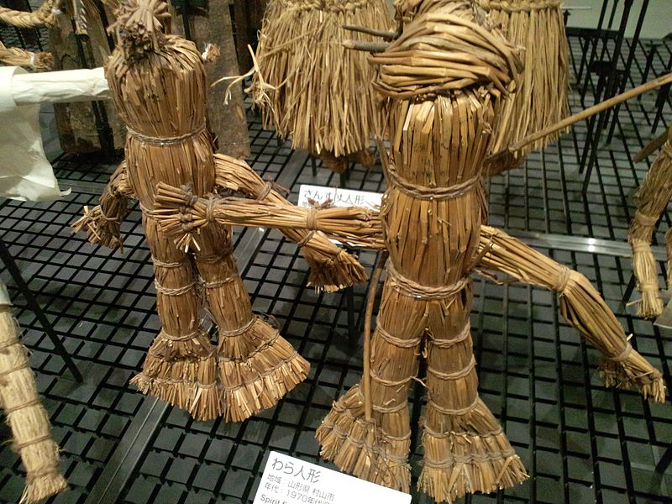
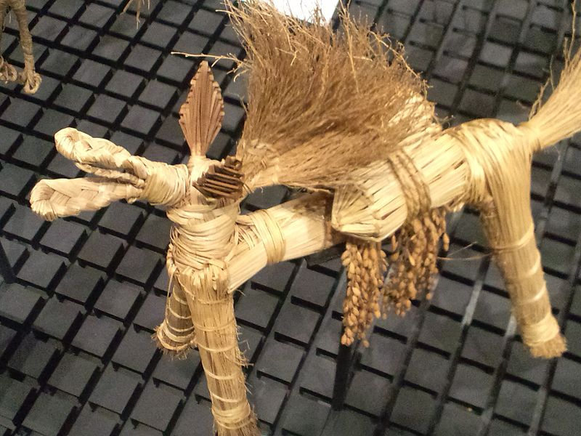
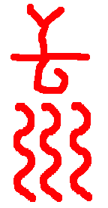
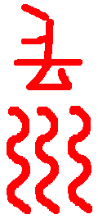
https://commons.wikimedia.org/wiki/File:National_Museum_of_Ethnology,_Osaka_-_Spirit_figures_(Straw_dolls)_-_Murayama_City,_Yamagata_Pref._-_Collected_in_the_1970s.jpg
https://commons.wikimedia.org/wiki/File:National_Museum_of_Ethnology,_Osaka_-_Straw_horses_-_Festival_%22D%C3%B4soshin-matsuri%22_-_Daisen-ch%C3%B4,_Tottori_pref._-_Made_in_1978.jpg
Yanajin33, CC BY-SA , via Wikimedia Commons
The straw doll/horse/dog were discarded outside the village after they had possessed the bad things in the village.
radical
”water”
They were washed into the river to drive away the bad things from the village.
to float on the current

Slide 9

https://commons.wikimedia.org/wiki/File:National_Museum_of_Ethnology,_Osaka_-_Spirit_figures_(Straw_dolls)_-_Murayama_City,_Yamagata_Pref._-_Collected_in_the_1970s.jpg
https://commons.wikimedia.org/wiki/File:National_Museum_of_Ethnology,_Osaka_-_Straw_horses_-_Festival_%22D%C3%B4soshin-matsuri%22_-_Daisen-ch%C3%B4,_Tottori_pref._-_Made_in_1978.jpg
Yanajin33, CC BY-SA , via Wikimedia Commons
radical ”water”
The straw doll/horse/dog were washed into the river to drive away the bad things.
https://commons.wikimedia.org/wiki/File:Lazurite.jpg
Didier Descouens, CC BY-SA 4.0, via Wikimedia Commons
the color of the clear current resembles the lapis-lazuli
→ lapis-lazuli
radical ”king”
→ symbol of “king” → precious stone

Slide 10

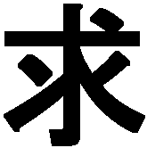

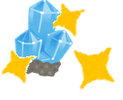

mine
to seek out the precious stones because of you want/need/require them.
→ want, need, require
radical “king”
the object that was needed as a symbol of the authority.
polished & round object, sphere, ball

Slide 11
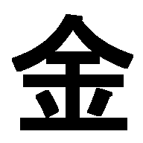
mine
ore, mine
metal
  gold
    money
tunnel
shaft
tunnel
tunnel
ore, crystal
ore, crystal

Slide 12
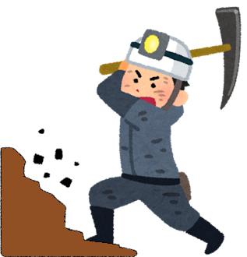

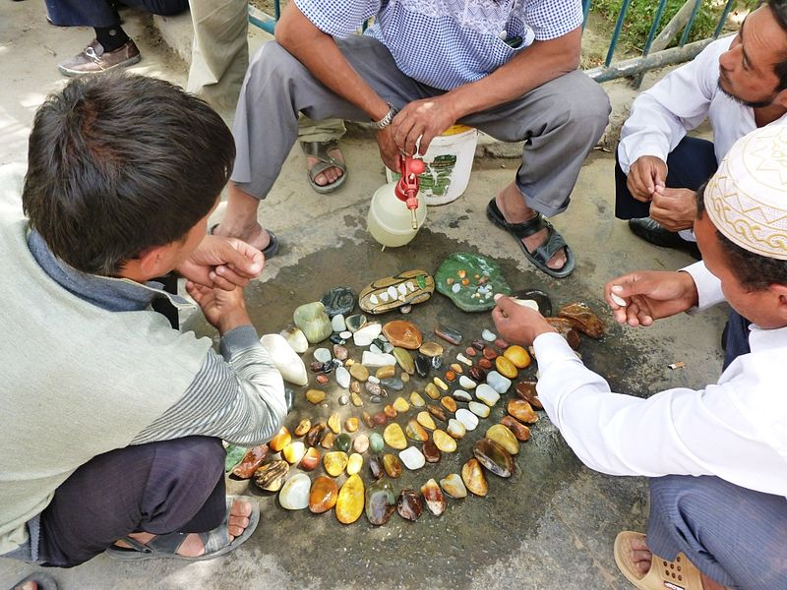
mine
ore, mine, crystal
→ metal, money
https://commons.wikimedia.org/wiki/File:Jades_for_sale_at_Khotan_Jade_Market.jpg
John Hill, CC BY-SA 3.0, via Wikimedia Commons
Chinese jade (symbol of political or religious authority)
→ precious stone → ball

Slide 13
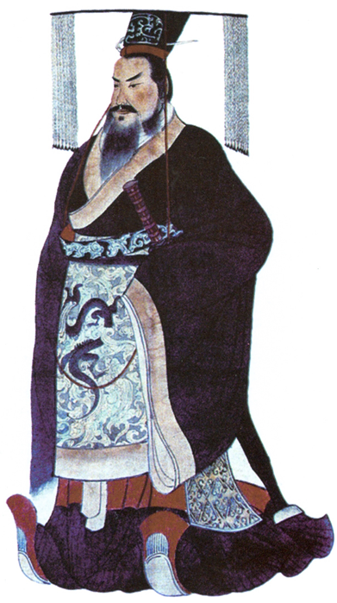

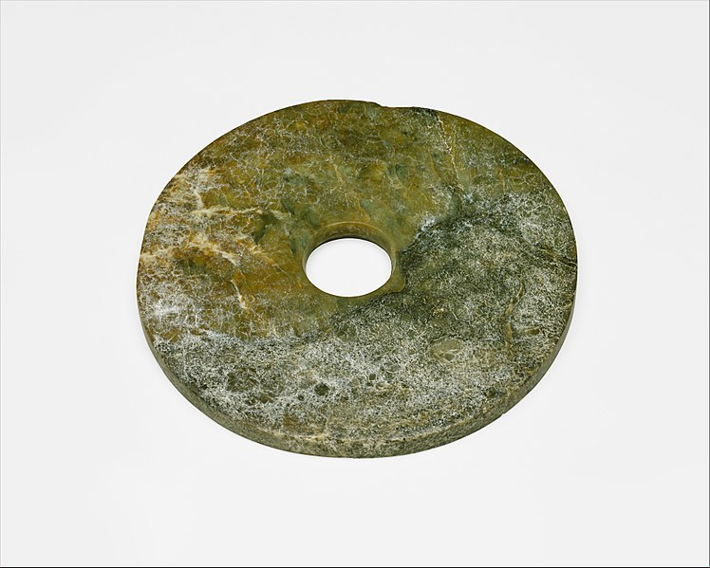
the heaven
Emperor/king can travel between the three worlds.
→ emperor, king
the world of human
the world for the dead (ancestors)
Chinese jade (symbol of political power or religious authority)
→ polished & round stone → precious stone → ball
https://commons.wikimedia.org/wiki/File:%E6%96%B0%E7%9F%B3%E5%99%A8%E6%99%82%E4%BB%A3%E8%89%AF%E6%B8%9A%E6%96%87%E5%8C%96_%E7%8E%89%E7%92%A7-Ritual_Object_(Bi)_MET_DT204.jpg
Metropolitan Museum of Art, CC0, via Wikimedia Commons

Slide 14
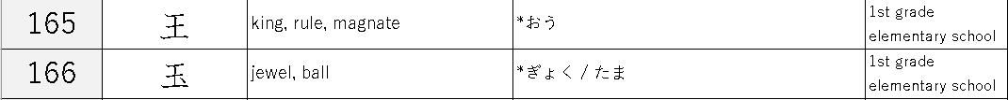



the heaven
Emperor/king can travel between the three worlds.
→ emperor, king
the world of human
the world for the dead (ancestors)
territory
kingdom
→ country, nation
Chinese jade (symbol of political power or religious authority)
→ symbol of emperor/king
https://commons.wikimedia.org/wiki/File:%E6%96%B0%E7%9F%B3%E5%99%A8%E6%99%82%E4%BB%A3%E8%89%AF%E6%B8%9A%E6%96%87%E5%8C%96_%E7%8E%89%E7%92%A7-Ritual_Object_(Bi)_MET_DT204.jpg
Metropolitan Museum of Art, CC0, via Wikimedia Commons

