Slide 1
Free Kanji Material 無料漢字教材 kanji0127-0134 新城直樹
本漢字教材は個人、法人、商用、非商用問わず無料でご利用頂けます。
ただし，一部の画像ファイルはクリエイティブ・コモンズ・ライセンスに基づいて利用していますので，例えば，ご自身で加工・編集したものを公開・配布する場合は自己責任で条件をお守りください。
書き順のGIFファイルは全て新城が作成したものです。書き順のGIFファイルを編集・加工するために編集用ファイルがほしいという方はご連絡ください（RealPaintで作成しましたので，rliファイルをお渡しします）。

Slide 2

本教材は，下記のPRQMakerの語彙リスト（1006kanji_VocabularyList.xlsx）に基づき作成しています。
http://isu.skr.u-ryukyu.ac.jp/staff/arashiro/

Slide 3

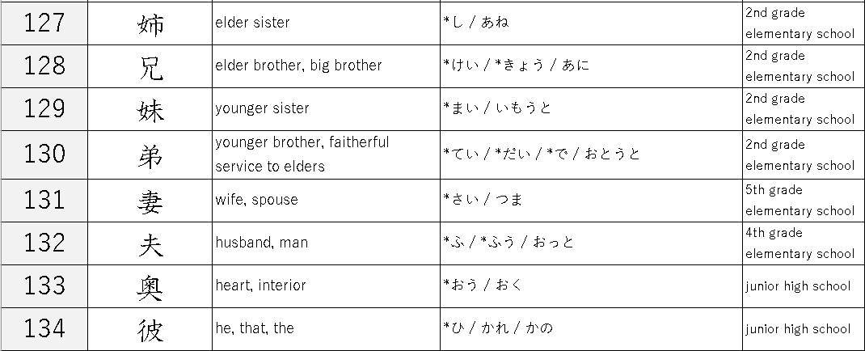

Slide 4
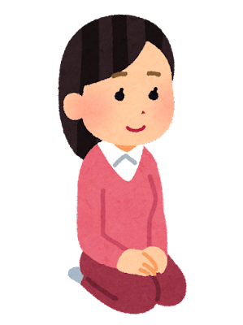


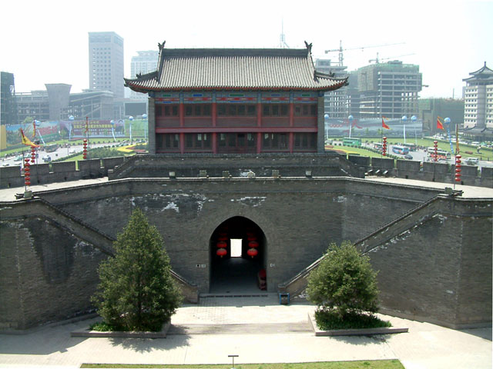
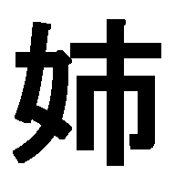
radical “female”
older one
bigger one
older sister 姉
city 市
town
younger sibling
village
city gate and city wall
→ city
older sister
https://commons.wikimedia.org/wiki/File:XiAn_CityWall_SouthGate3.jpg
西安城墙-南门-瓮城 Jamguo 摄于
Jamguo . CC BY-SA 1.0

Slide 5
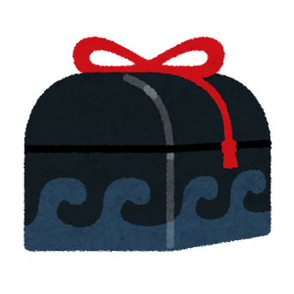

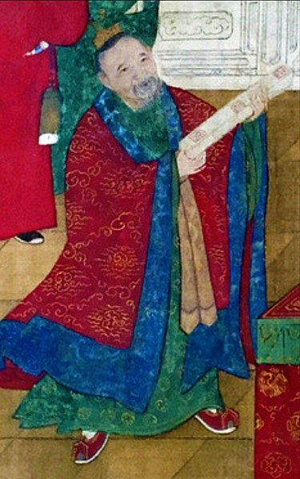
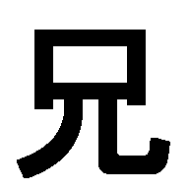

A person who makes offerings to ancestors at a festival/clan ritual
the eldest brother
elder brother
offering
https://commons.wikimedia.org/wiki/File:%E9%82%B5%E5%85%83%E7%AF%80.jpg
顧鼎臣撰, Public domain, via Wikimedia Commons

Slide 6
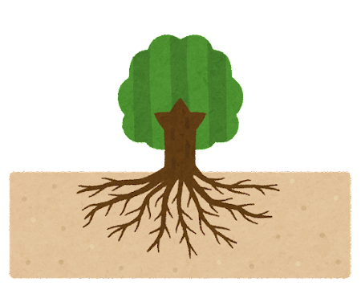
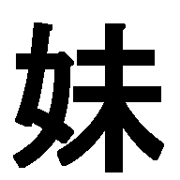
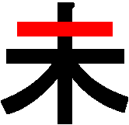
radical “female”
sister + at the very back
the youngest sister
elder sister
treetop→ the very end of a tree

Slide 7
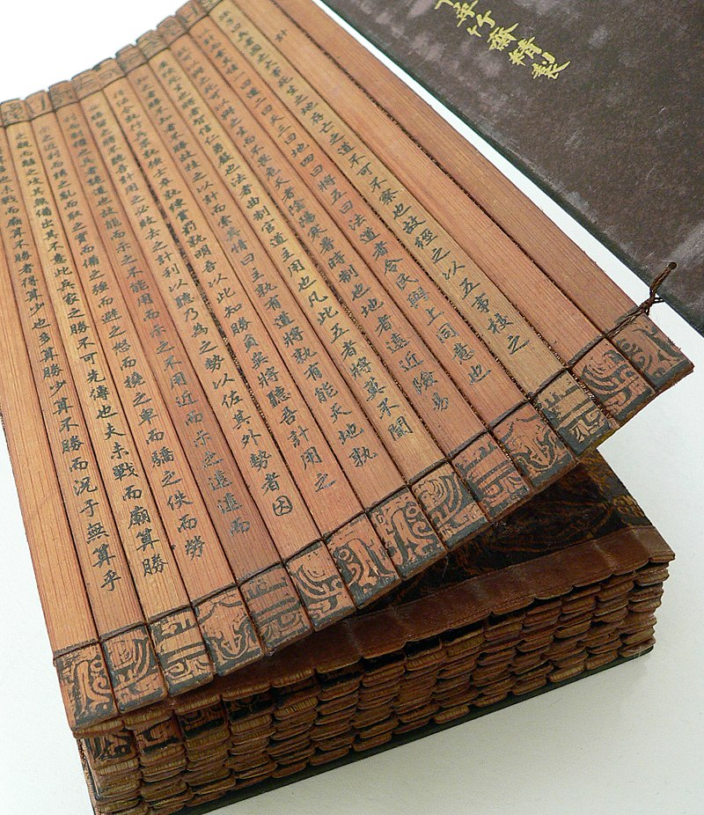
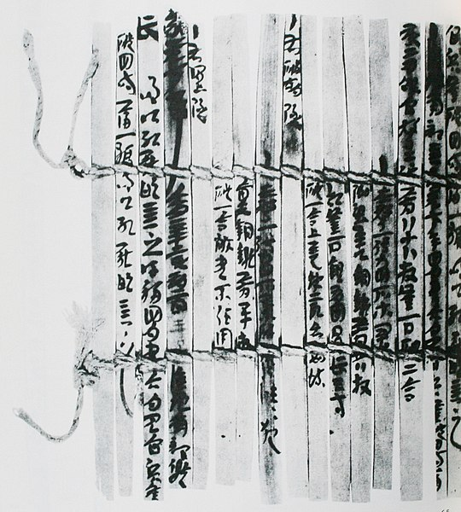
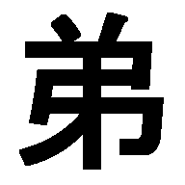
https://commons.wikimedia.org/wiki/File:Bamboo_book_-_binding_-_UCR.jpg
vlasta2, bluefootedbooby on flickr.com, CC BY 2.0 <https://creativecommons.org/licenses/by/2.0>, via Wikimedia Commons
https://commons.wikimedia.org/wiki/File:Woodstrips_document_ACE98_Niya_China.jpg
HEIBONSHA, Public domain, via Wikimedia Commons
…
last slip
Bamboo and wooden slips that are the main media for writing documents in ancient China.
binding cords
last slip → low position
younger brother
the youngest brother

Slide 8
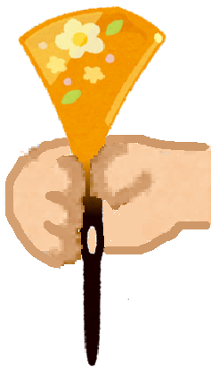
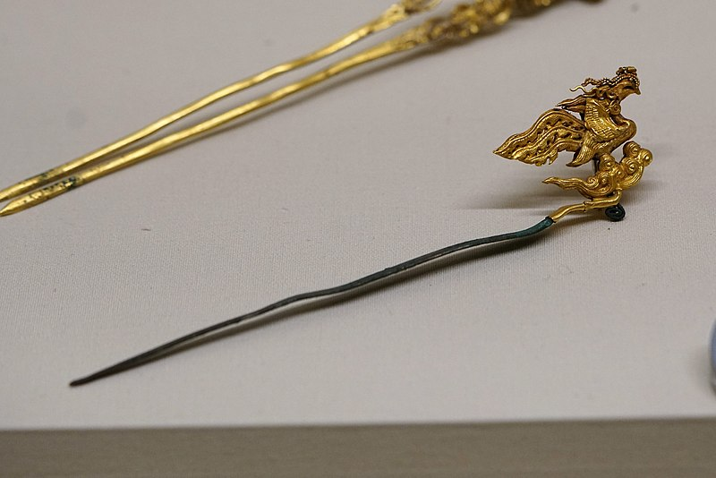
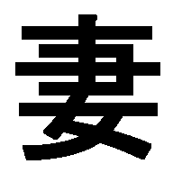

https://en.wikipedia.org/wiki/Chinese_hairpin
https://en.wikipedia.org/wiki/File:凤首金顶银簪03564.jpg
Augusthaiho, CC, BY-SA 4.0
a hairpin that indicates its wearer is married
→ wife
radical “female”

Slide 9

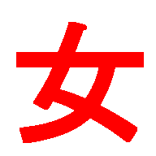
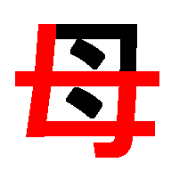

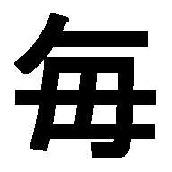
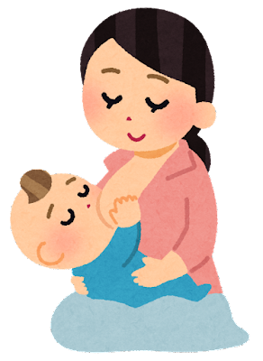
https://en.wikipedia.org/wiki/Chinese_hairpin
https://en.wikipedia.org/wiki/File:凤首金顶银簪03564.jpg
Augusthaiho, CC, BY-SA 4.0
woman, female
hairpin
mother
mother
Hairpins were used as every day hair ornaments in ancient China
→ every

Slide 10
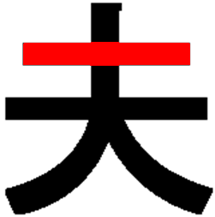
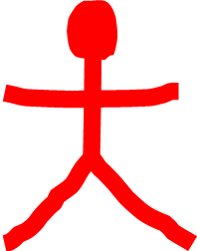
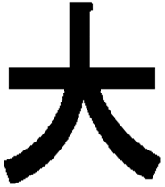
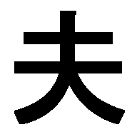
https://en.wikipedia.org/wiki/Chinese_hairpin
https://en.wikipedia.org/wiki/File:凤首金顶银簪03564.jpg
Augusthaiho, CC, BY-SA 4.0
a hairpin that indicates its wearer is married
husband, man
big gesture
big, large
大人（たいじん）： a honorific title for the family/clan/community head

Slide 11

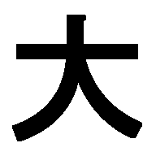
big gesture
→ big, large

Slide 12
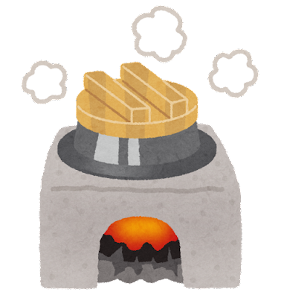


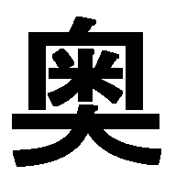
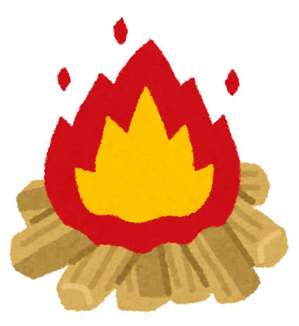
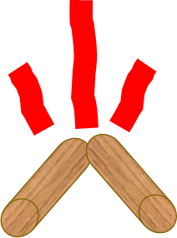

rice
cooking stove
The kitchen is located at the back of the house.
→ in the back, inner
firewood

Slide 13
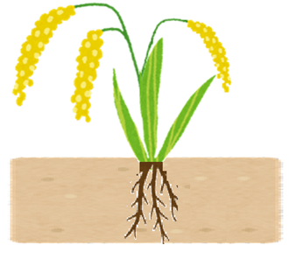
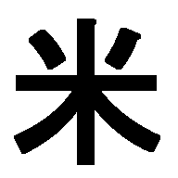
pictograph of “rice plant”
→ rice
About 200 years ago, USA was written as “亜米利加,” and the second kanji “米” became to mean USA.
# the first kanji “亜” had already been used as an abbreviation for “Asia (亜細亜).”

Slide 14
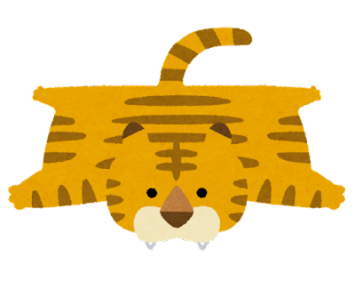


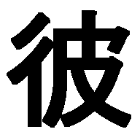
animal skin
crossroad
skin/leather
hand
the other side across the street
to take the flesh from the animal's body and leave the skin.
1st part = bone, 2nd part = flesh, 3rd part = skin
→ third party person → he

